Slide 1

Impact of Covid-19 on Global Market Indices
University of Toronto SCS: Fintech Bootcamp
Group-6 Team Members:
Amit Sharma
Mihir Mehta
Richa Dudani
Zeldi Snyman
Date: July 30th, 2020

Slide 2
Motivation and Summary
Covid-19’s impact on the major global stock market indices
Questions asked:
Was there any relevant impact on major global stock market indices?
What was the difference in actual and forecasted prices due to Covid from mid february, 2020 till date?
What are the changes in the future projected returns over 20 years?
What is the Comparison of future projected returns over different time frames pre and post covid?
Summary of the findings
Global Stock market crashed at the outset of the Covid-19 pandemic, but from the data, we noticed a slight recovery across most market indices
The trend analysis suggests that Shanghai Composite index was not as impacted as the other market indices. Over the Covid-period, the forecasted market prices were between 10%-20% higher than actual market prices for S&P 500 and FTSE 100, but 2% lower for Shanghai composite. The recovery of Shanghai composite was much better than the other market indices.
S&P 500 forecasted investment returns outcomes
Decrease in expected investment returns post the Covid-19 event in Feb/March 2020.
Decrease in expected investment returns when comparing 1 year data to 5 years of data

Slide 3
Data, Cleanup & Exploration
Data extraction:
14 Global market stock indices and commodities selected
Closing market index price data: Google Finance and Yahoo Finance (through API and Pandas Data Reader)
5 Years daily data: 01-01-2015 to 24-07-2020
Data cleanup and exploration:
Imported csv files, sort & renaming
Concatenate all tickers: consider data types and drop nulls
Explore data and divide data into 1 year and 5 years (pre- and post-covid) datasets.
Pre-covid: up to 2020-02-14
Post-covid: up to 2020-07-24
Challenges:
Finding 1 source of data for all ticker prices
Time taken to extract and clean-up data was more than expected
Country / Commodity | Stock Market Index | Ticker Abbr. | Data Source | Raw data file name
USA | S&P500 | ^GSPC | Yahoo Finance | INX.csv
 | Nasdaq | ^IXIC | Yahoo Finance | NDAQ.csv
 | Dow Jones | ^DJI | Yahoo Finance | DJI.csv
CANADA | TSX Composite | ^GSPTSE | Yahoo Finance | TSX.csv
 | TSX60 | TX60 | Google Finance | TX60.csv
UK | FTSE100 | UKX | Google Finance | UKX.csv
EUROPE | Euro Stoxx 50 | ^STOXX50E | Yahoo Finance | SX5E.csv
CHINA | Shangai Comp | 000001.SS | Yahoo Finance | SHA.csv
JAPAN | Nikkei | ^N225 | Yahoo Finance | NI225.csv
HONG KONG | Hangsen | ^HSI | Yahoo Finance | HSI.csv
AUSTRALIA | S&P ASX20 | ^AXJO | Yahoo Finance | XJO.csv
ITALY | FTSE Milano Indice Di borsa | FTSEMIB | Google Finance | FTSEMIB.csv
GOLD | Gold | GC=F | Yahoo Finance | Gold.csv
CRUDE OIL | Crude Oil | CL=F | Yahoo Finance | CrudeOil.csv

Slide 4
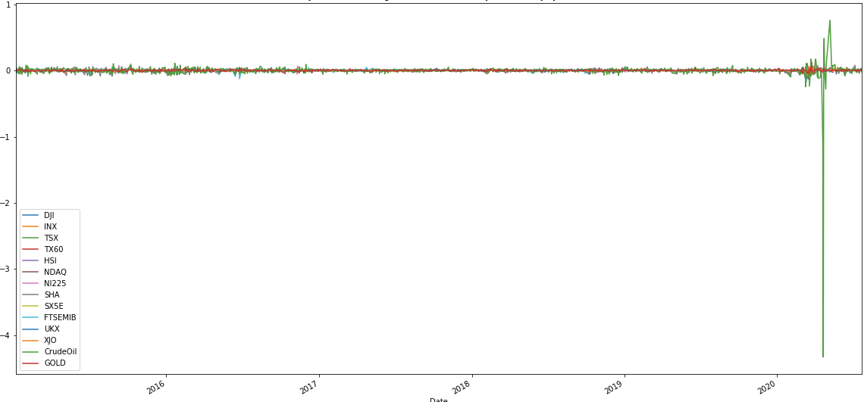
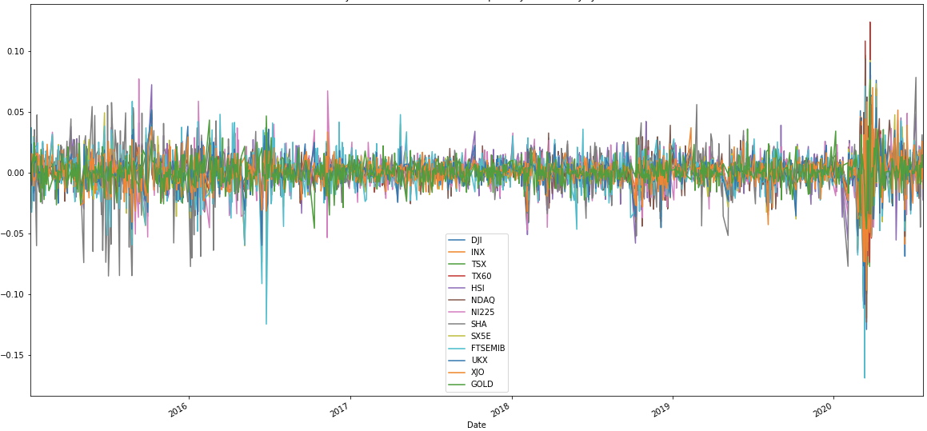
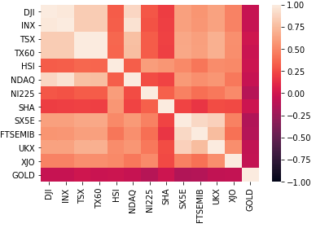
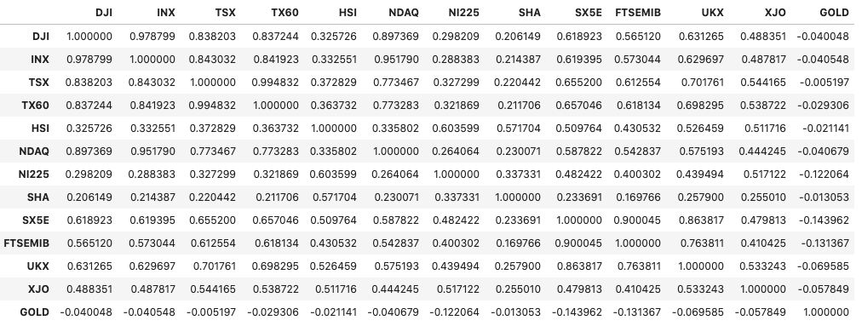
Insights while exploring data
Crude Oil daily returns was skewing the data and hence, we dropped the same from the analysis
Decision made to limit the number of indices to only 6, based on correlation matrix and representation of major global markets.
Daily Returns for Market Indices - Jul 2015 - Jul 2020 with Crude Oil as an outlier
Daily Returns for Market Indices - Jul 2015 - Jul 2020 post removal of Crude Oil
Correlation table and heatmap for various indices

Slide 5
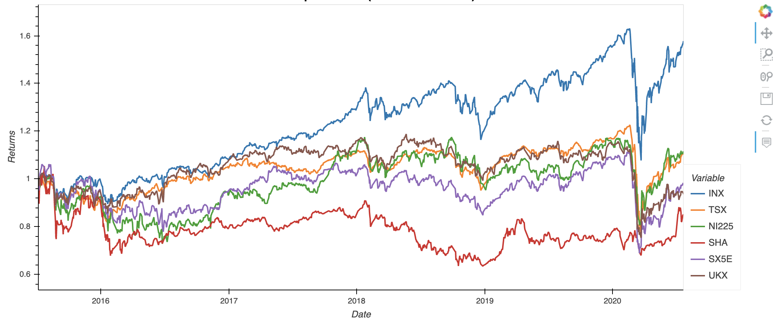
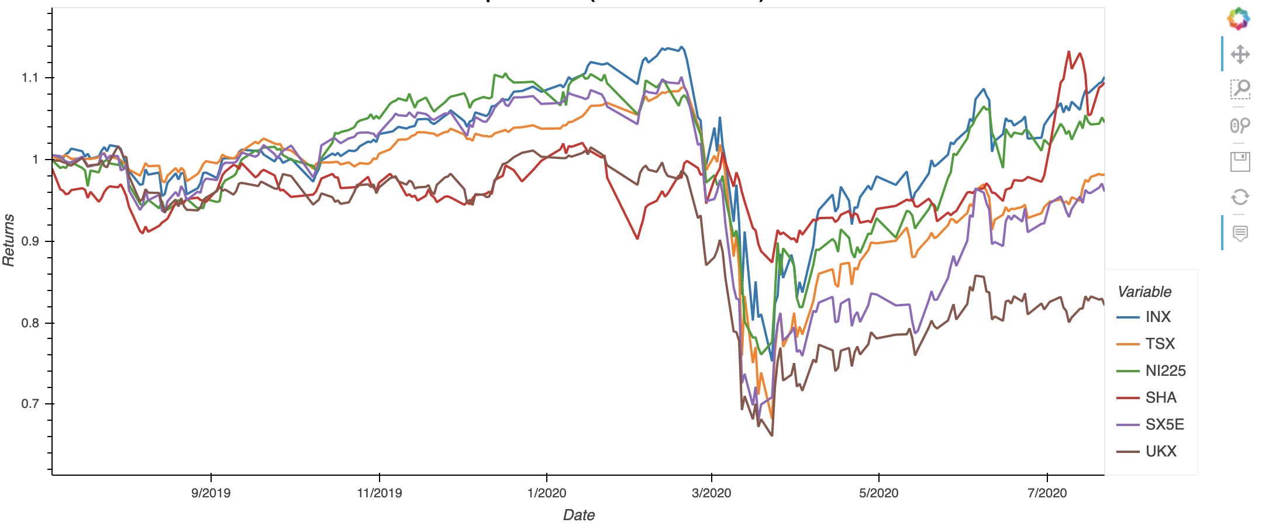
Data Analysis
Cumulative Returns for Market Indices - Jul 2015 - Jul 2020
6 Stock market Indices: S&P 500, FTSE100, TSX, NI225, Shanghai, SX5E
Daily and cumulative returns comparing pre- and post-covid periods for different datasets
Standard deviation and rolling standard deviation plots
Comparison of actual market prices vs. forecasted market prices: S&P 500, Shanghai Composite, FTSE100 (period 15 Feb ‘20 to 24 Jul ‘20)
Monte Carlo simulations (x 1000 over 20 years):
SP500 - return on investment for 1 year and 5 year datasets, for period pre- covid and post-covid
Cumulative Returns for Market Indices - Jul 2019 - Jul 2020
Notes:
Was there any relevant impact on major global stock market indices?
What was the difference in actual and forecasted prices due to Covid from mid february, 2020 till date?
What are the changes in the future projected returns over 20 years?
What is the Comparison of future projected returns over different time frames pre and post covid?
Calculation of daily returns
STd calculation
Commulative returns

Slide 6
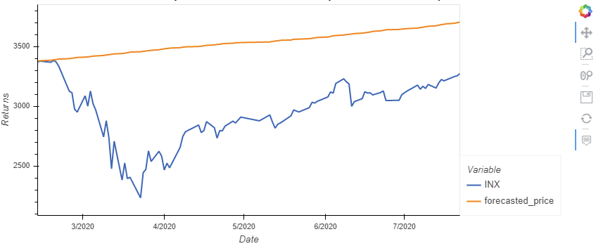
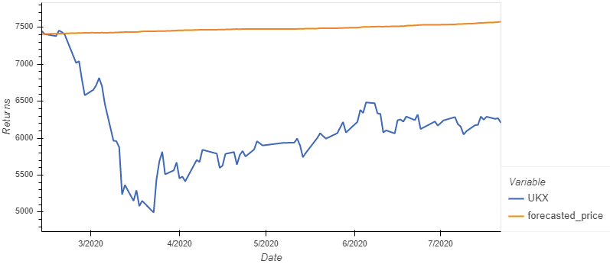
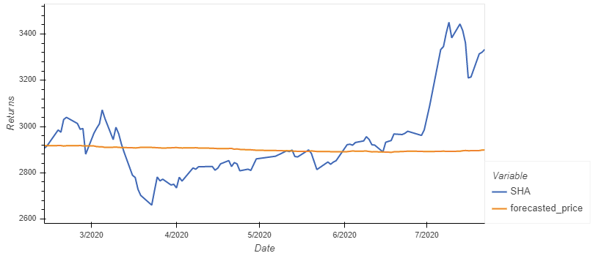
Findings (1/2)
Actual vs Forecasted market index price (14 Feb - 24 July 2020):
Forecast was based on historical 1 year price data up to 14 Feb 2020.
Actual market price for both S&P 500 and FTSE 100 is less than forecasted price
Actual market price for Shanghai composite is slightly higher than forecasted price
Actual vs forecasted average market index price comparison
Stock market Index | Actual price (avg) | Forecasted price (avg) | % change
S&P 500 | 2,949.20 | 3,535.90 | 19.89%
FTSE100 | 6,102.51 | 7,481.80 | 22.60%
Shanghai Composite Index | 2,949.58 | 2,901.32 | -1.64%
Actual vs Forecasted stock market Prices over Covid period
S&P 500
FTSE 100
Shanghai Composite Index
Notes:
Was there any relevant impact on major global stock market indices?
What was the difference in actual and forecasted prices due to Covid from mid february, 2020 till date?
What are the changes in the future projected returns over 20 years?
What is the Comparison of future projected returns over different time frames pre and post covid?
Calculation of daily returns
STd calculation
Commulative returns

Slide 7
Findings (2/2)
SP500 Projected investment returns:
Decrease in investment return projections when comparing data pre- and post-covid
5 year dataset significantly lowers the variance as compared to 1 year rolling data
SP500 Expected Returns in 20yrs ($20k Initial Investment)
 | PRE - COVID | POST - COVID
Time Frame for Analysis - 1 YEAR
Percentiles | Mar 1, 2019 - Feb 14, 2020 | Jul 1, 2019 - Jul 24, 2020 | % Change
10% | 1,217,980 | 22,424 | -98.05%
50% | 2,565,598 | 201,941 | -91.70%
90% | 4,961,664 | 1,438,188 | -69.58%
Time Frame for Analysis - 5 YEARS
Percentiles | Jan 1, 2015 - Dec 31, 2019 | Jan 1, 2015 - Jul 24, 2020 | % Change
10% | 84,823 | 51,821 | -38.43%
50% | 201,846 | 186,082 | -7.50%
90% | 434,759 | 578,997 | 33.13%
Notes:
Was there any relevant impact on major global stock market indices?
What was the difference in actual and forecasted prices due to Covid from mid february, 2020 till date?
What are the changes in the future projected returns over 20 years?
What is the Comparison of future projected returns over different time frames pre and post covid?
Calculation of daily returns
STd calculation
Commulative returns

Slide 8
Postmortem
Difficulties faced during analysis:
Lack of time to run and analyse multiple simulations for different market indices
Not much data for post covid period
Challenge for the whole team to collaborate on a single project as first time programmers
Questions discussed but remain unanswered:
Analysis of forecast vs actual price for more indices other than S&P 500, SHA & FTSE 100
Enrich data with actual covid cases per country, creating a demographic comparison with the stock market index
Monte Carlo Simulation for more indices (pre-covid and post-covid period)
If more time available, we would like to:
Analyse other global stock market indices
Apply more concepts learnt in class
Simplified code through use of functions
Spend more time researching the reasons for the outcome of the analysis, e.g market index news and economic policies, country specific covid policies
Find the vaccine for Covid 😜

Slide 9


Slide 10


